Slide 1
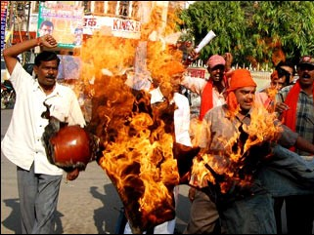
Hindu attacks against Christian pastors in India
Photo courtesy of asianews.it

Slide 2
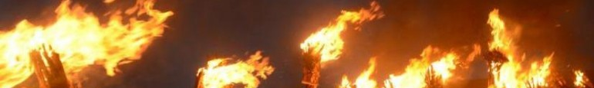
John 15.18-21 NET: “If the world hates you, be aware that it hated me first. If you belonged to the world, the world would love you as its own. However, because you do not belong to the world, but I chose you out of the world, for this reason the world hates you. Remember what I told you, ‘A slave is not greater than his master.’ If they persecuted me, they will also persecute you. If they obeyed my word, they will obey yours too. But they will do all these things to you on account of my name, because they do not know the one who sent me.”
Pakistani torches after burning a Christian couple
Photo courtesy of ijreview.com

Slide 3
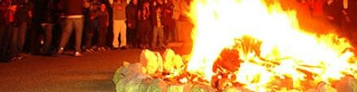
John 15.22-25: “If I had not come and spoken to them, they would not be guilty of sin. But they no longer have any excuse for their sin. The one who hates me hates my Father too. If I had not performed among them the miraculous deeds that no one else did, they would not be guilty of sin. But now they have seen the deeds and have hated both me and my Father. Now this happened to fulfill the word that is written in their law, ‘They hated me without reason.’”
Burning New Testaments in Israel
Photo courtesy of jewishjournal.com

Slide 4
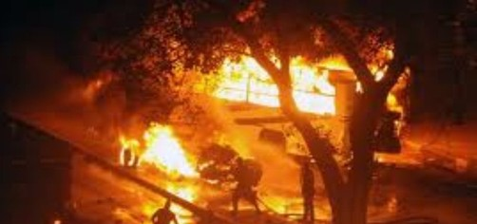
John 15.26-27: “When the Advocate comes, whom I will send you from the Father– the Spirit of truth who goes out from the Father– he will testify about me, and you also will testify, because you have been with me from the beginning.”
Burning church in Egypt
Photo courtesy of examiner.com

Slide 5
John 15.26-27: “When the Advocate comes, whom I will send you from the Father– the Spirit of truth who goes out from the Father– he will testify about me, and you also will testify, because you have been with me from the beginning.”
καὶ ὑμεῖς δὲ μαρτυρεῖτε
= and you also testify / are testifying
or = and you also must testify
Burning church in Egypt
Photo courtesy of examiner.com

Slide 6
John 16.1-6: “I have told you all these things so that you will not fall away [σκανδαλίζω]. They will put you out of the synagogue, yet a time is coming when the one who kills you will think he is offering service to God. They will do these things because they have not known the Father or me. But I have told you these things so that when their time comes, you will remember that I told you about them. I did not tell you these things from the beginning because I was with you. But now I am going to the one who sent me, and not one of you is asking me, ‘Where are you going?’ Instead your hearts are filled with sadness because I have said these things to you.”

Slide 7
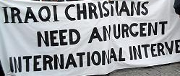
John 16.7-11: “But I tell you the truth, it is to your advantage that I am going away. For if I do not go away, the Advocate will not come to you, but if I go, I will send him to you. And when he comes, he will prove the world wrong [ἐλέγχω] concerning sin and righteousness and judgment– concerning sin, because they do not believe in me; concerning righteousness, because I am going to the Father and you will see me no longer; and concerning judgment, because the ruler of this world has
been condemned.”
Photo courtesy of freerepublic.com

Slide 8
John 16.12-15: “I have many more things to say to you, but you cannot bear them now. But when he, the Spirit of truth, comes, he will guide you into all truth. For he will not speak on his own authority, but will speak whatever he hears, and will tell you what is to come. He will glorify me, because he will receive from me what is mine and will tell it to you. Everything that the Father has is mine; that is why I said the Spirit will receive from me what is mine and will tell it to you.”
For the sake of propriety, I omitted the picture
of slaughtered Nigerian Christians…

Slide 9
Right now…
  Expect and prepare for trouble.
When trouble comes…
  Stand firm in faith and obedience.
  Testify for Christ.
  Rejoice in hope.

